Slide 1

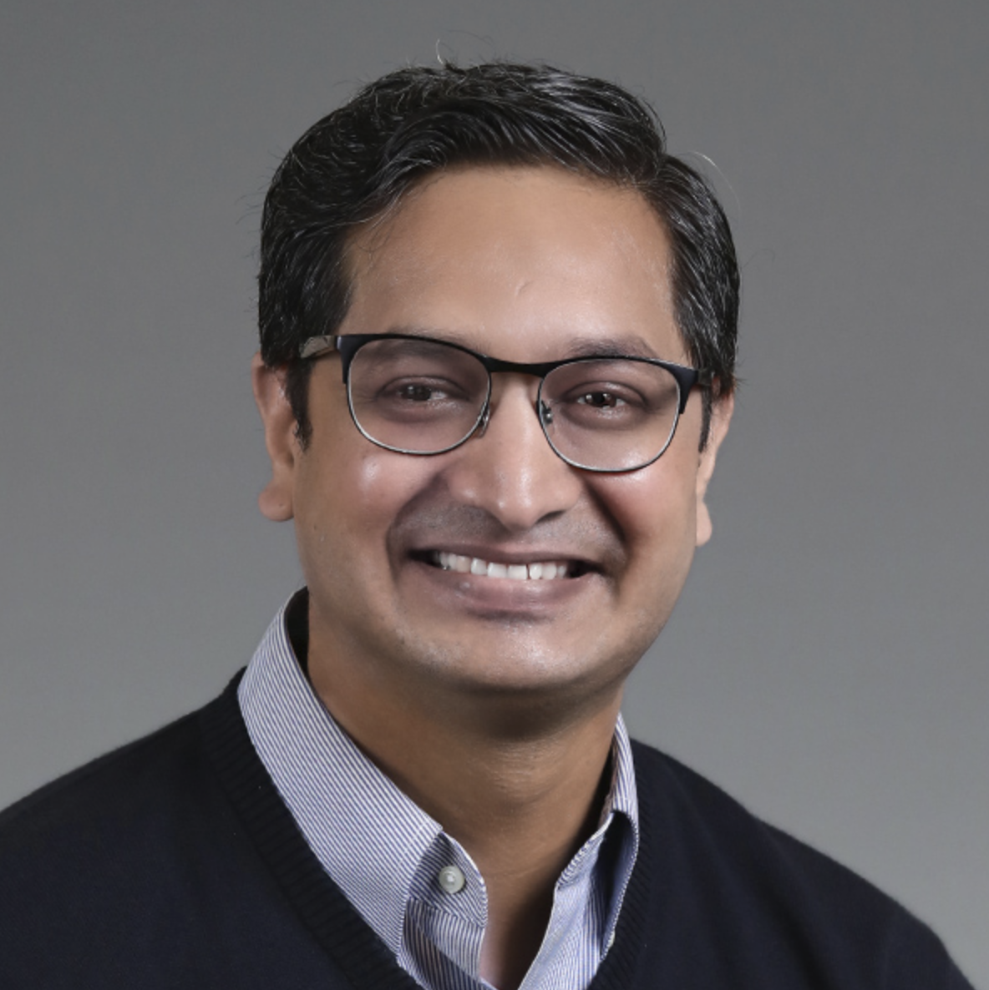
Workshop
Mastering Stable Diffusion
Module 4
Methods, Jobs and Tools of Stable Diffusion
Sandeep Singh
Head of Applied AI, Beans AI

Slide 2

Module 4 Purpose
Theme of this module is: Hands-On Exercises and Encouraging People to Try the ideas themselves.
Train Stable Diffusion from Scratch? Yes and No!
How to Train Stable Diffusion at Scale.
Ethical Implications of Training a Stable Diffusion Models.
Stability.ai: OpenAI, but much better!
DreamStudio and StableStudio: Blessings of Stable Diffusion.
Stable Diffusion WebUI Introduction and Purpose.
Running Automatic1111 WebUI on RunPod GPU Environment.
Analyzing Prompts, Prompts Matrix.
Prompt Strengths and Weights.
Prompt Editing and Blending for Stable Diffusion.
Understanding and Using XYZ Plots for Stable Diffusion.

Slide 3

So Much of Diffusion: Feeling Fused?
Equipped with lots of concepts, but what now? How to productize my knowledge? What are the resources? How to plan an Stable Diffusion Initiative?
Envisioning: Concept to Product.
Do I need to remember All the Math? Yes and No!
Reuse Code or Model Weights or both or None?
What are Concrete Steps?

Slide 4

Train or Fine Tune?
2 Options: Train: From Scratch, Fine-Tune: Foundational Model
So? Well, it depends, Answer is: Yes and No! Yes: if you are forced to by factors No: Almost Always, Fine-Tune!
Factors, which might force you to train from scratch:
Text Prompts need to be very specialized.
Need to create new and original concepts in images. E.g. All Possible Types of lesions in X-Ray Images.
Not so favorable Copyright or Compliance of foundation models.
Not enough resources like: Money, Time, Human Capital for Evaluation etc.

Slide 5
Tools and Considerations to Train
If decided to train from scratch, then tricks to attain it is:
Plan to acquire large dataset of interest. Most challenging part! Data Augmentations viable?
Plan to avail the required capacities, only limited GPUs available on this planet!
Plan to avail significant funding with room to play.
While training, considerations are:
Distributed Computing: 100s of GPUs, if not 1000s to do whole thing from scratch.
Data Parallelism: Each device processes a different mini-batch of data.
Mixed Precision Training: A technique that uses a combination of lower and higher precision floating-point numbers, which can significantly reduce the training time.
Gradient Accumulation: If model does not fit entirely in memory, Accumulate gradients over multiple mini-batches before performing a single update.
Large Batch Training: Consider using large batch training techniques like LAMB (Large Batch Adam) or LARS (Layer-wise Adaptive Rate Scaling) to enable training with larger batch sizes while maintaining stability.
Plus all other Deep Learning Techniques like: Gradient Clipping, Distributed Batch Normalization, Checkpointing

Slide 6
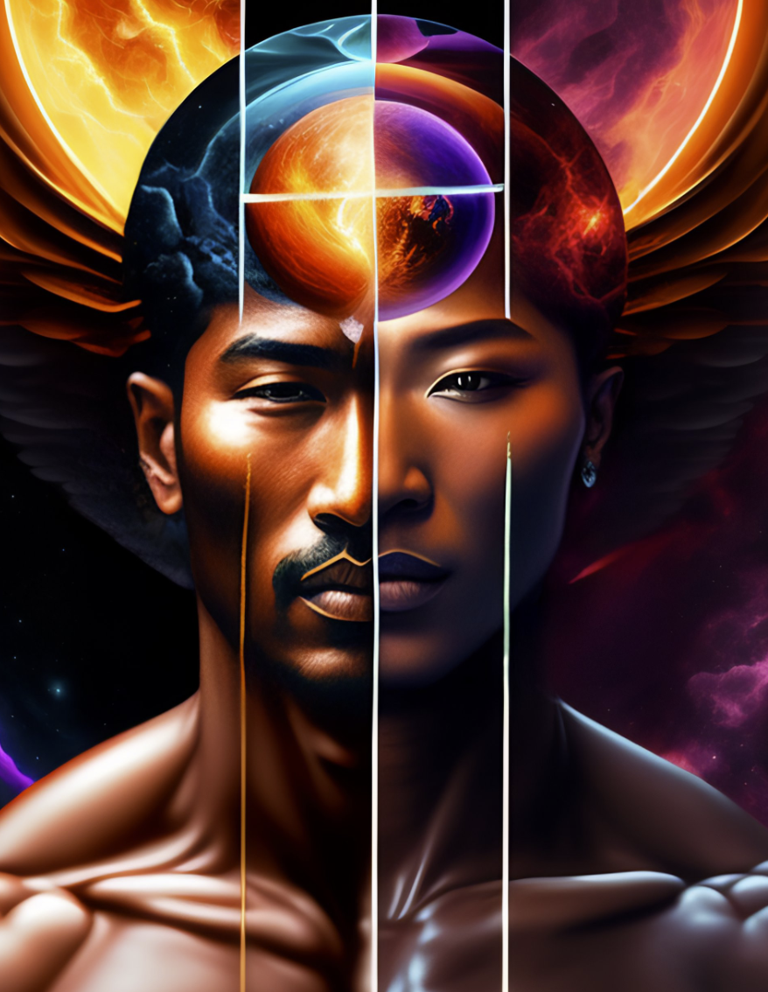
Ethics: A Word Before Everything
Stable Diffusion has potential to use for a lot of good, but much more bad! Few issue are:
Bias: Stable Diffusion is likely to reflect the biases of data, which comes from biased society. This is why it is important to use a diverse dataset when training Stable Diffusion.
Privacy: A very realistic Image generator, which can do conceptual modification. SD models can be used to impersonate real people.
Misinformation: Stable Diffusion can be used to generate images that are misleading or false. Could be used to spread misinformation or to create propaganda.
Tips for using Stable Diffusion ethically:
Be aware of the biases in the dataset. For a pre-trained model, Get the model's data card to analyze.
Use a diverse dataset. If you are training your own model, then it is important to use a diverse dataset. Diversity sould be for target use-cases.
Imagine The bad use-cases: Mandate the guard rails for bad use cases.
Educate others: Images and Videos say nothing in today’s world.

Slide 7

Ethics: An Example
Drug Dealers: Mostly Spanish and African Looking
Terrorists: Mostly Middle Eastern looking men
Prison Inmates are mostly African and brown skinned.
These are extreme degree of biased results.

Slide 8

Stability.AI: Champion of Open Source
- Dedicated to open source generative AI. They have released several open source models and tools.
- Committed to making generative AI technology accessible to everyone:
releases under the CC BY-SA 4.0 license, which means that they can be freely used, modified, and shared.
- Strong advocate for the responsible use of generative AI.
Main Stability.AI's contributions to open source generative AI:
- Stable Diffusion: First and one of the most popular open source generative AI models, and it has been used to create a wide variety of images, including realistic portraits, fantasy landscapes, and abstract art.https://github.com/Stability-AI/StableDiffusion
- StableLM: Suite of small and efficient language models that can be used for a variety of tasks, including text generation, machine translation, and question answering. https://github.com/Stability-AI/StableLM
- StableVicuna: StableVicuna is an open source RLHF chatbot that can be used to interact with humans in a natural way. StableVicuna is trained on a large dataset of human conversations, and it can be used to answer questions, provide information, and even generate creative content.

Slide 9
DreamStudio and StableStudio: Blessings of Stable Diffusion
How you want to consume tools provided by Stability.ai:
Basic Text to Image: (No Code Option) - Runs on public CPU - Very Slow! https://huggingface.co/spaces/stabilityai/stable-diffusion
Hugging Face diffusers library: (Write Python Code) - Run on own GPU setup.
DreamStudio: StabilityAI’s paid Image Generation platform. https://dreamstudio.ai/
StableStudio: StabilityAI’s Open Source Image Generation tool. Exactly like DreamStudio, But will have to run on own infrastructure.
Stable Diffusion WebUI by Automatic1111: Best of both world. https://github.com/AUTOMATIC1111/stable-diffusion-webui Build on open source and lets you customize the code as per need.
We will use this!

Slide 10

Review of Deployment Options for SD WebUI
We can use three main hosting locations for Stability Diffusion Tools as:
Google Colab: https://colab.research.google.com/ Most Preferred to run some quick code with almost zero setup cost.
Kaggle Kernels: https://kaggle.com/ Cheap and Good Enough for the purpose at hand.
StableStudio: Run in Local Machine with GPU.
RunPod.io: Official Infrastructure for this workshop. This is what we will use to experiment Stable Diffusion tools and WebUI.
Free Credit is available for us to use at RunPod.io

Slide 11
Review of Deployment Options for SD WebUI
We can use three main hosting locations for Stability Diffusion Tools as:
Google Colab: https://colab.research.google.com/ Most Preferred to run some quick code with almost zero setup cost.
Kaggle Kernels: https://kaggle.com/ Cheap and Good Enough for the purpose at hand.
StableStudio: Run in Local Machine with GPU.
RunPod.io: Official Infrastructure for this workshop. This is what we will use to experiment Stable Diffusion tools and WebUI.
Free Credit is available for us to use at RunPod.io

Slide 12
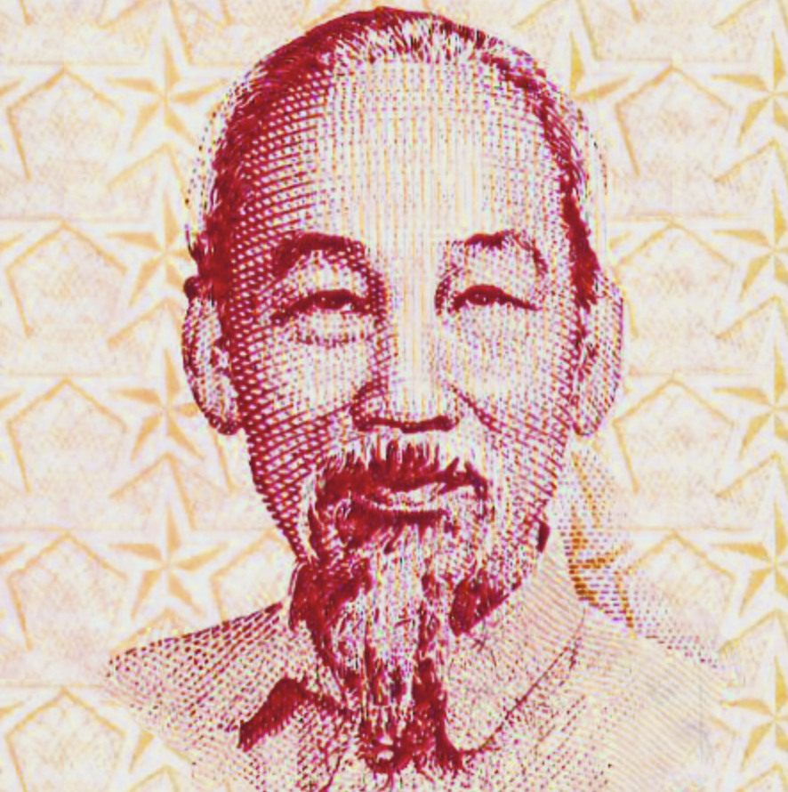
Stable Diffusion WebUI: Great Convenient Tool
Developed by github user: Automatic1111. https://github.com/AUTOMATIC1111/stable-diffusion-webui
It is meant for Users, Developers and Researchers Alike.
UI is built using programmer friendly Gradio.
Huge feature list and dynamically added as new research pops!
Simple Steps to get Up and Running: - git clone - download models from huggingface repository - launch.py
Simply change the code and introduce your own experiments.
This is ready sandbox for developing your own research.
Simple use –share to launch.py and you will have publicly shared url.
Needs GPU access to run Diffusion Iterations.
We will run Stable Diffusion WebUI from RunPod.io instance.

Slide 13
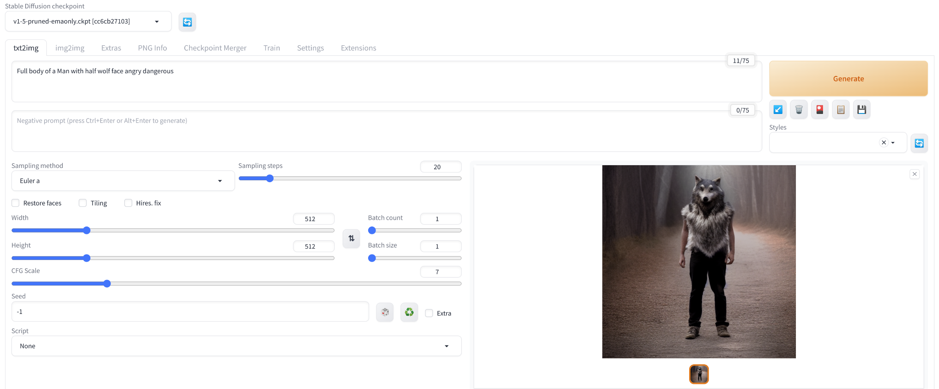
Stable Diffusion WebUI: Great Intuition in UI
Simple UI
Easily Extensible

Slide 14

RunPod: Run Stable Diffusion WebUI
Hope Everybody has RunPod instance running.
Go to RunPod Instance and Upload/Open the notebook named:
Module_4_Stable_Diffusion_WebUI_A1111.ipynb
Run the whole Notebook from top to bottom. (It might take 15 minutes for whole thing)
Click on the HuggingFace Gradio App Link. (Let the Notebook be running)
Make Sure to Terminate the RunPod Instance after use.

Slide 15
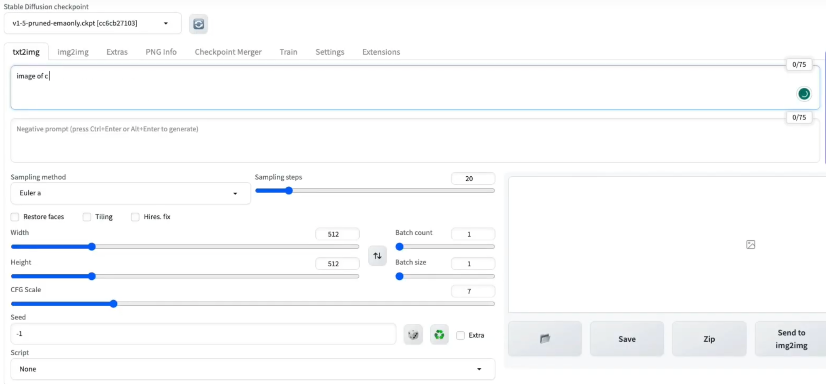
Stable Diffusion WebUI: Anyone Stuck?
Checkpoint:
Everybody is able to get to WebUI? Need Assistance?
*If anyone is stuck, move them to Kaggle.

Slide 16
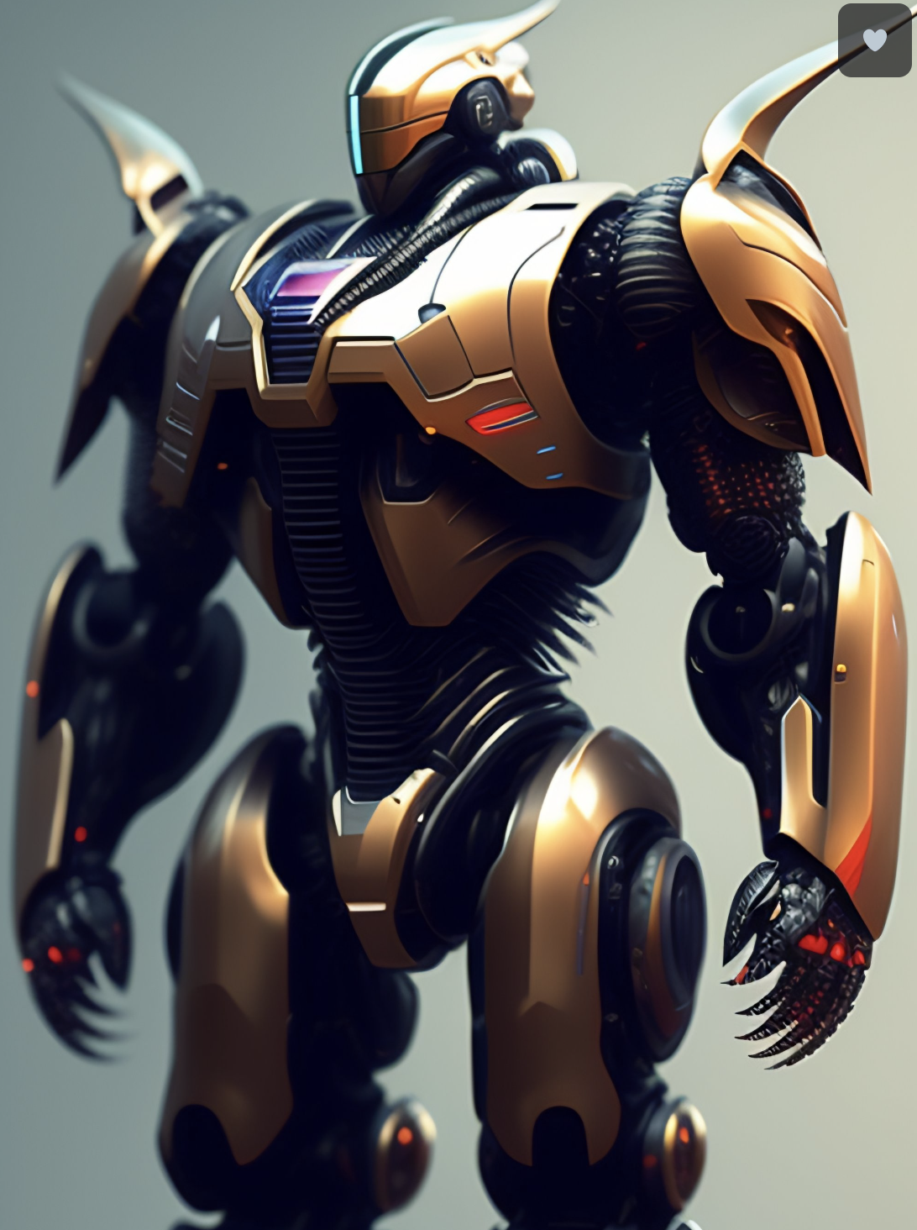
Stable Diffusion WebUI: Why are we using WebUI?
We need to understand lots of new concepts and techniques which are built on top of Stable Diffusion.
To demonstrate all the concepts built on top of Stable Diffusion.
It is easiest way to verify your idea and build new type of tool on the fly with minimal code change.
WebUI is the fastest way to integrate with other people/researchers/platforms models or code.
Simply because you can change the code as per your organizations need.
To explain the nuances of Prompt Engineering for Images generation.
Last, but not least, it is Awesome!

Slide 17
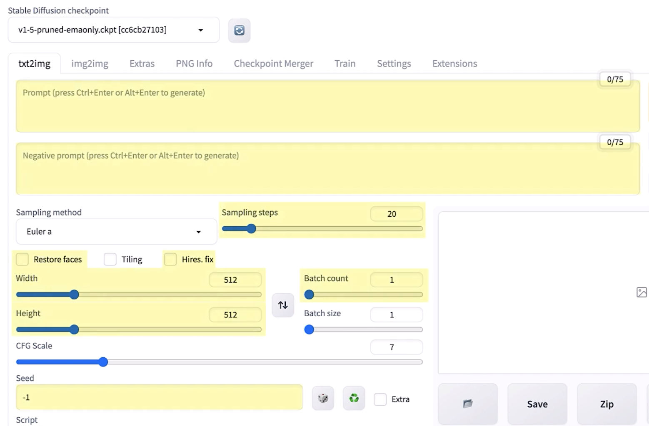
Stable Diffusion WebUI: Text-2-Image
Checkpoints: Models available.
Text Prompt
Negative Prompt: Request to avoid specific concept.
Sampling Steps: Timesteps from diffusion model. More the better.
Batch Count: # of images.
Restore Faces: To refine faces.
Dimension: Self-explanatory, but model dependent. Up-sampler is an option.
CFG Scale: in-a-bit
Seed: -1(Random seed), else fixed provided value to reproduce the same output.
DEMO
Most basic use of Stable Diffusion.
Quick Tour of Text-2-Image WebUI.

Slide 18
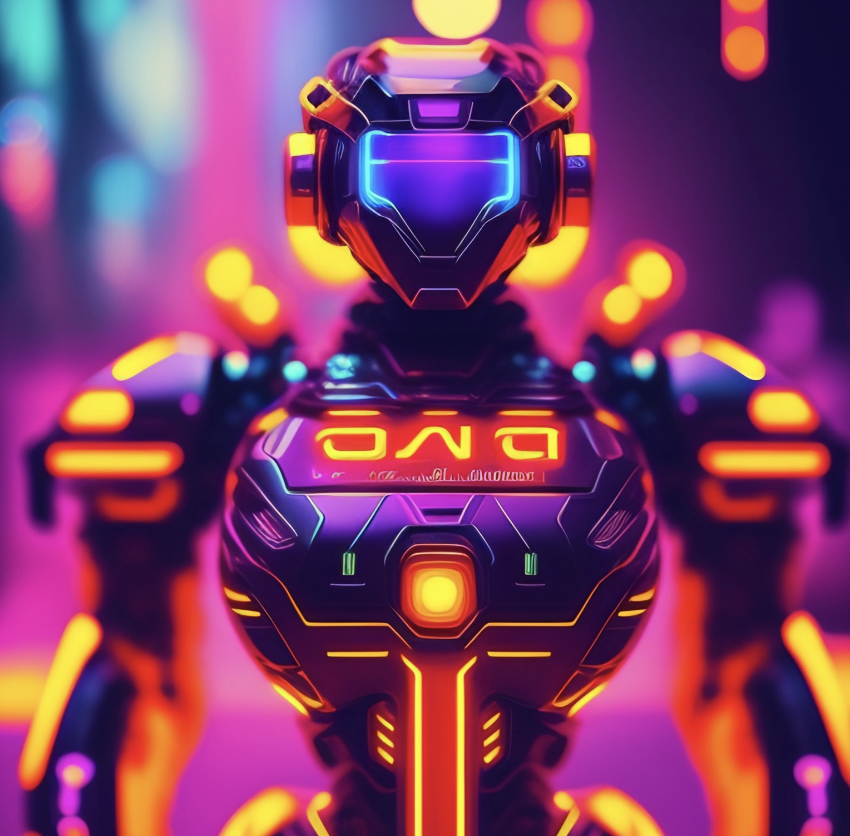
Prompt Engineering with Stable Diffusion
Similar to LLMs prompt Engineering, but nuanced.
Unlike LLMs, it much more iterative because:
Solutions are built on top of each other.
Components of Image generation Prompt: Subject(normally a noun) Description of Subject(normally a phenomenon or a verb) Style (3D, oil painting, Van Gogh, Sketch etc.) Instrumentation (Camera name, parameters f1.8, 50mm etc.) Quality (4k, HD, 3D, Super Resolution, Photorealism)
Central Idea: Don’t be lazy, Write in detailed manner. Don’t be too general, be specific if needed. Learn it, it is quite an Art, not much science!
Prompt: Futuristic lots of ai robots doing cool things, neon style, hyperdetailed, cinematic, intricate, sharp, focus

Slide 19
Analyzing Prompts with Prompt Matrix
Prompt Matrix is a technique in Stable Diffusion, which can be used to: Generate images with combination of thoughts with one Prompt
Imagine We are trying to find right combination of concepts in prompt, Prompt Matrix is amazing technique to employ.
Example: We want to generate Image of Landscape as: We want to evaluate combination of: River (and/or) Mountain (and/or) Wooden Cabin
Following Prompts need to be entered one by one to generate images as: A beautiful realistic landscape by the river. A beautiful realistic landscape by the river and Mountain . A beautiful realistic landscape by the river and Mountain Wooden Cabin A beautiful realistic landscape by the river and Wooden Cabin Many more combinations..!
Or Single Prompt with all the above optional concepts as: A beautiful realistic landscape | by the river | and Mountain | Wooden Cabin

Slide 20
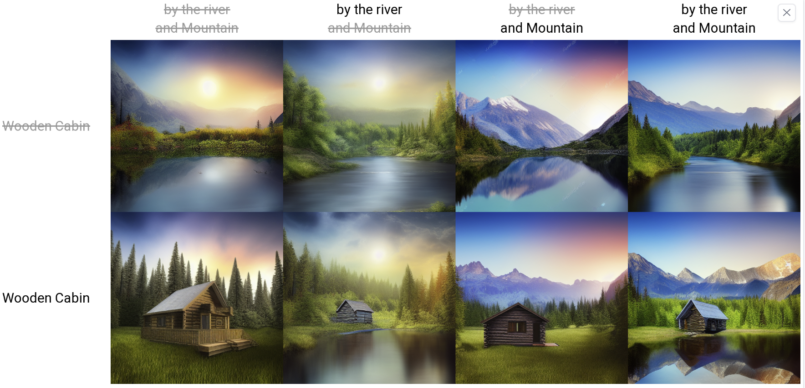
Analyzing Prompts with Prompt Matrix
Prompt for Prompt Matrix generation: A beautiful realistic landscape | by the river | and Mountain | Wooden Cabin
All in one shot! Power of Prompt Matrix!

Slide 21
Prompt Strength and Weights
To Emphasize and De-Emphasize particular concept in the prompt.
To Emphasize: Surround the concept with () #default increase in weight by 10%
To De-Emphasize: Surround the concept with [ ] #default decrease in weight by 10%
To given custom Weights to particular concept, use the weights as: (concept :weight)
Examples:
A fruit basket having Apples, grapes, Oranges and Strawberry.
A fruit basket having Apples, grapes, Oranges and (Strawberry:1.1).
A fruit basket having Apples, [grapes], Oranges and Strawberry. A fruit basket having Apples, [grapes], Oranges and (Strawberry:1.1).
Demo
#Default weight of 1.0
#More Strawberry
#Less grapes
#More Strawberry and less grapes

Slide 22
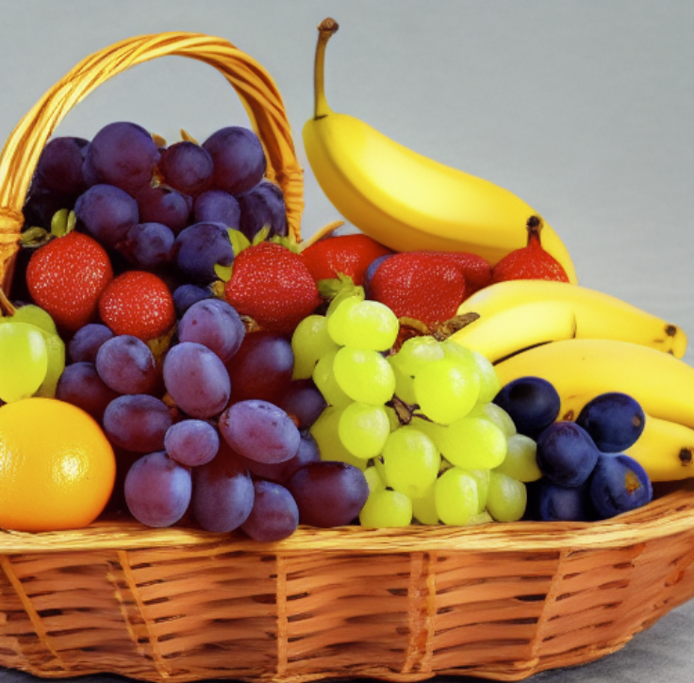
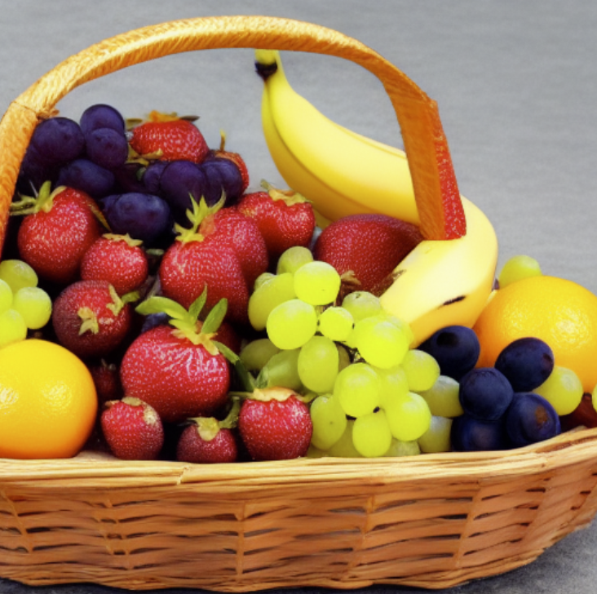
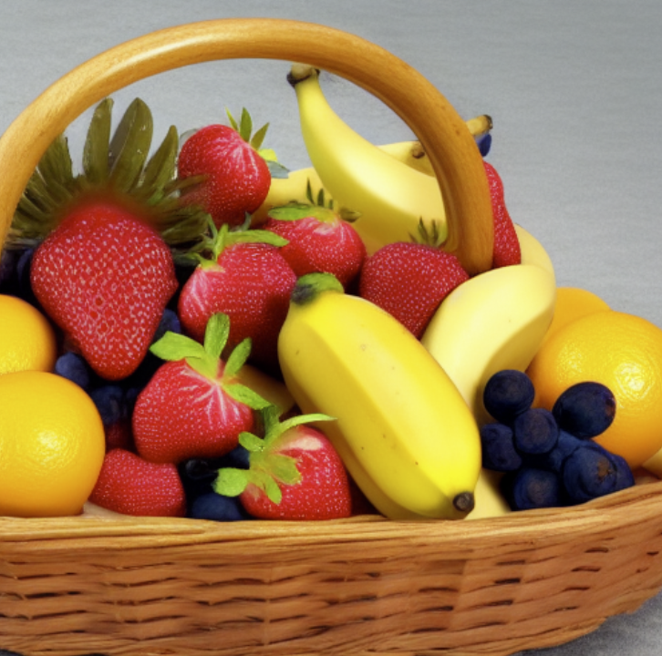
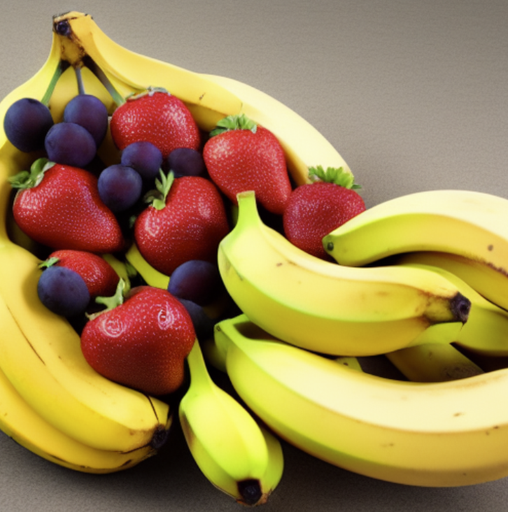
Prompt Strength and Weights - Experiments
A fruit basket having Banana, grapes, Oranges and Strawberry. #Default weight of 1.0
A fruit basket having Banana, grapes, Oranges and (Strawberry:1.2). #More Strawberry
A fruit basket having Banana, [grapes], Oranges and (Strawberry:1.2). #More Strawberry, less grapes
A fruit basket having (Banana:1.2), [grapes], Oranges and Strawberry. #Less grapes, more banana

Slide 23
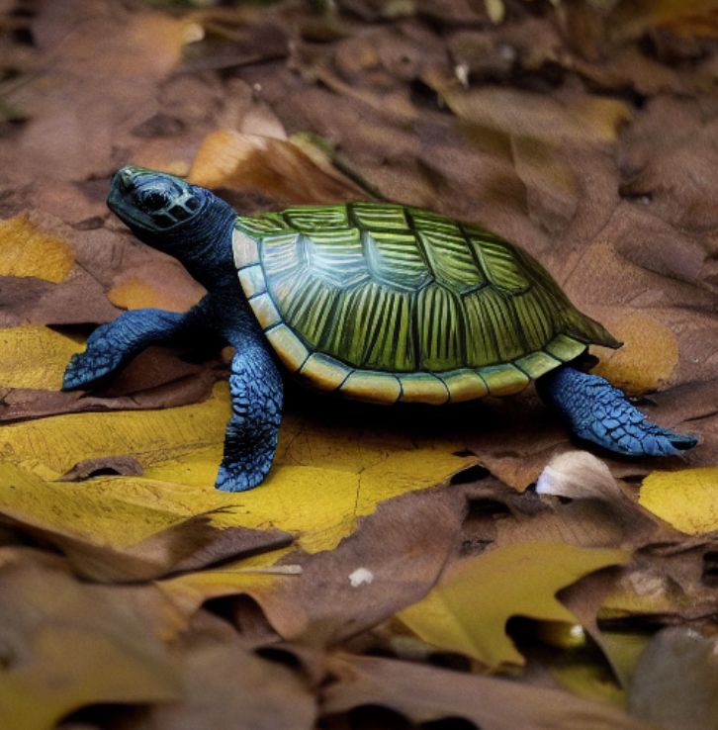
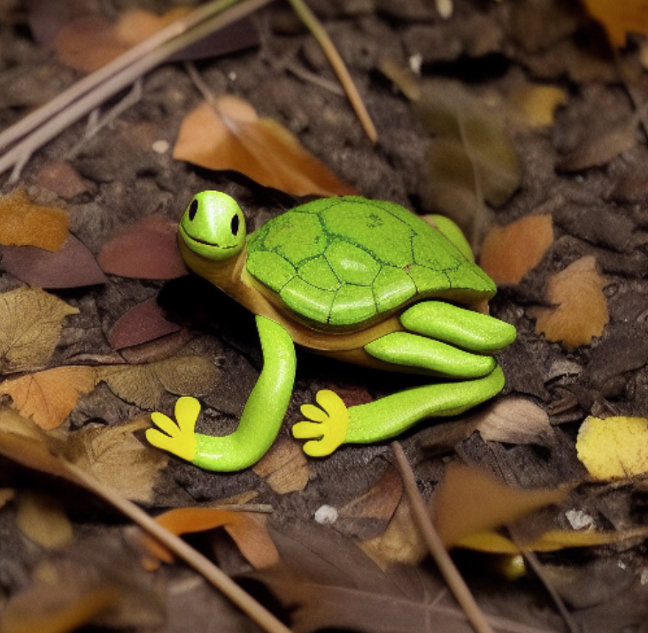
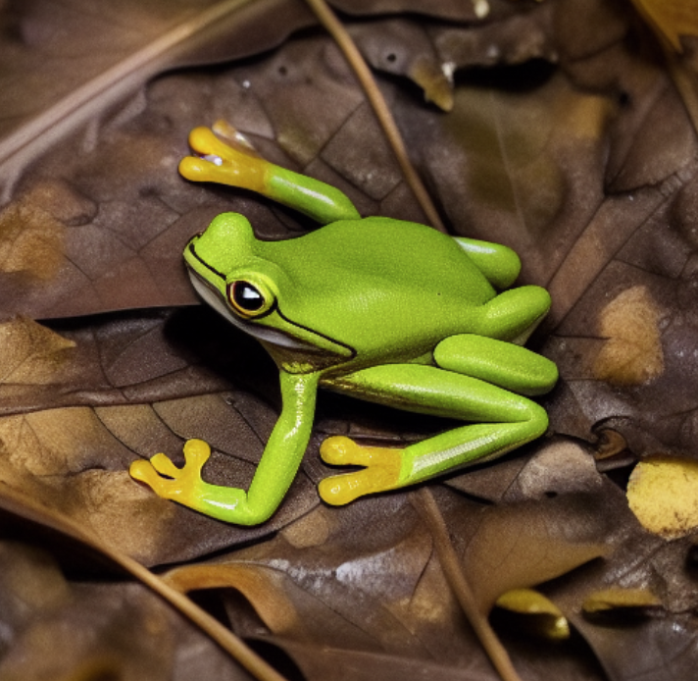
Prompt Editing and Blending for Stable Diffusion.
Prompt Blending is the concept, where we can switch the concept at particular time during out Reverse Diffusion Process.
This is useful to experiment with ideas and creativity is only limited by imagination.
A frog on the leaf in the forest
A turtle on the leaf in the forest
A [frog:turtle:0.5] on the leaf in the forest
Here, 0.5 values tells to switch the prompt after 50% steps of Diffusion Iteration.

Slide 24
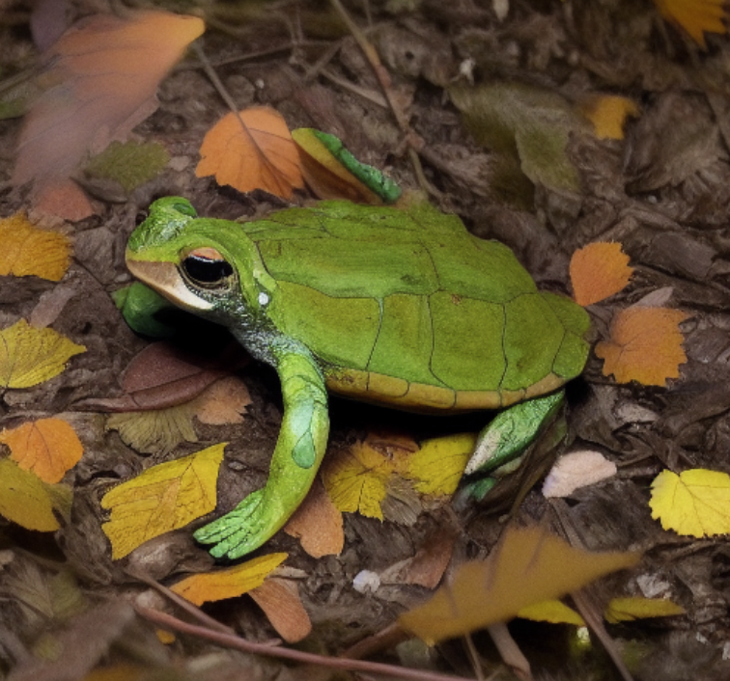
Prompt Editing and Blending for Stable Diffusion.
Another way of Prompt Blending Where we do not decide after what fraction of steps switch the prompt is: Switch the prompt concept alternatively after each step.
A [frog|turtle] on the leaf in the forest
Here Frog and Turle keep switching in after each step.
Another way to simulate alternate blending is : AND (in CAPS)
Ex. A frog AND turtle on the leaf in the forest

Slide 25
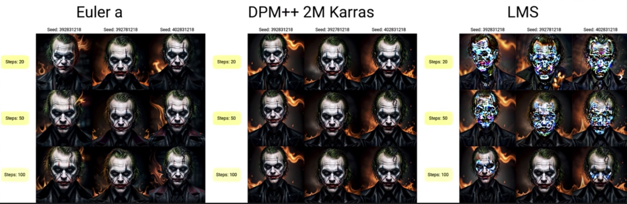
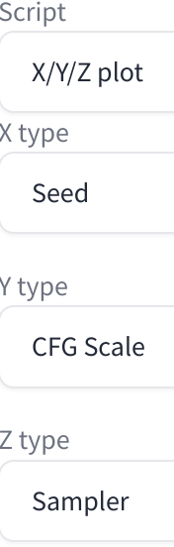
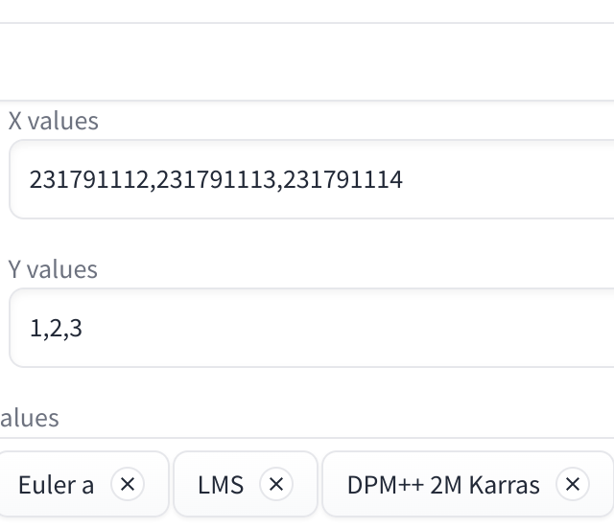
Using the XYZ Plots in Stable Diffusion WebUI
XYZ Plot in Stable Diffusion is a technique to:
Compare and contrast 3 set of Stable Diffusion Parameters
This is not just about Prompt, it is more about Stable Diffusion parameters.
Prompt: dark and gloomy, 8k, a closeup photo of Joker with flames in background, life like texture, dynamic composition, Fuji film XT2, 85 mm, F1.2, 1/80 shutter speed, bokeh, high contrast

Slide 26
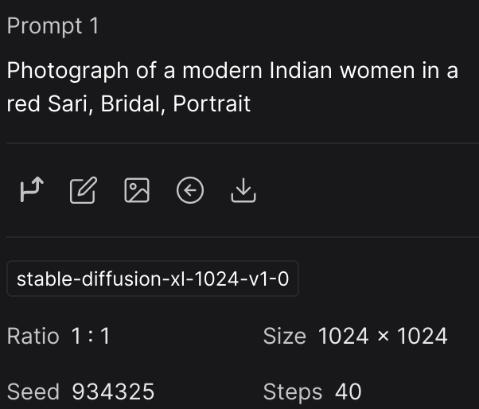
DreamStudio Demo
Login to use free Credit or enter payments details: https://dreamstudio.ai/generate
Very Easy to use, Great Quality.
Can take Very Detailed Prompts. More Dreamy and Traditional Looks in potos generated.
Lets you control and reuse parameter to very easily control the generation Process.

Slide 27
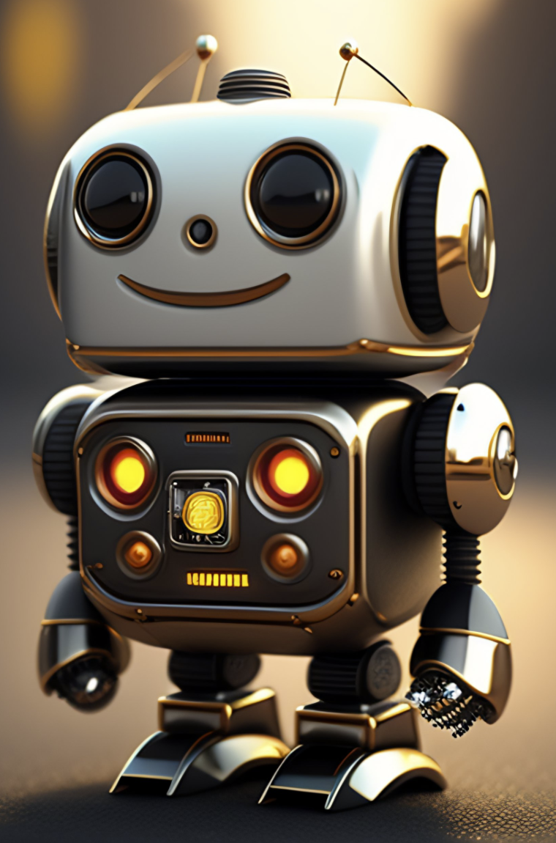
Questions?

Slide 28



